Slide 1

Final Year Project Presentation on
Identification Of Iris Flower Species Using Machine Learning
DEPARTMENT OF COMPUTER SCIENCE AND ENGINNERING
Guide :
Mrs. Asha ML
Presented by :
Ajeet Choudhary (1st17cs010)
Abhishek Kumar (1st17cs006)
Amit Kumar Sinha (1st17cs018)
Aditiya Kontikal(1st17cs008)

Slide 2
Problem Statement
Create the model that can classify the different species of the Iris flower.
Problem solving:
create the dataset.
Build the model
Train the model
Make predictions.

Slide 3
Project Objective
After the project has been settled, the computer should have the ability to aggregate three different classifications of Iris flower to three categories. The whole workflow of machine learning should work smoothly. The users do not need to tell the computer which class the Iris belongs to, the computer can recognize them all by itself. The final purpose of this project is to let everyone who read this thesis have a basic understanding of machine learning, the case study of Iris recognition will show how to implement machine learning

Slide 4
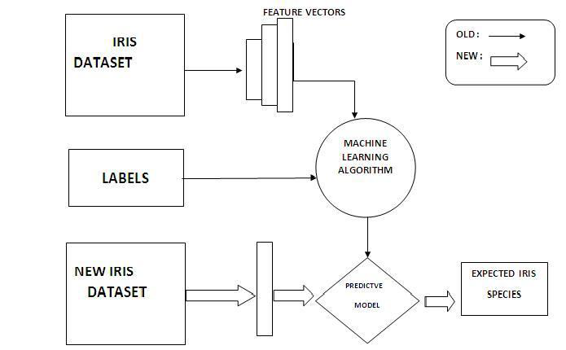
Proposed work
The proposed method comprises of sub-phases that is Loading and Modeling as schematic diagram of the proposed
model is given in figure.

Slide 5
Methodology
The objective of our methodology is to choose the best
classification model which performs well on iris flower
species identification. Learning models are created based on
three machine learning algorithms: Support Vector Machine
(SVM), Logistic Regression and K- Nearest Neighbor
(KNN) classifier. For developing these methods four iris
dataset features are used in the train and test datasets. All
these algorithms are implemented using scikit-learn tool kit
based on Python.
In this analysis we are comparing the accuracy of three
models and trying to find out which classification model
holds good. To improve model accuracy, we have also used
cross validation technique which evaluates the predictive
models by dividing the original sample data into a training
set in order to train the model and a test set to evaluate it.

Slide 6
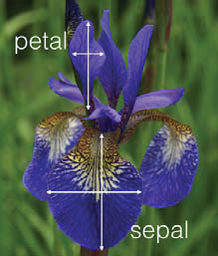
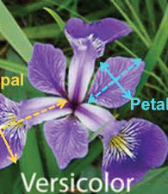
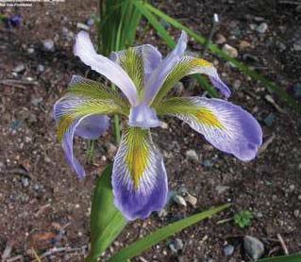
A. Dataset
For implementation purpose we have used Iris dataset
which is a multivariate dataset that quantifies the structural
variation of three species of iris flower. Classification is
done on the basis of flower species which are Iris-setosa,
Iris-versicolor, Iris-verginica. The dataset consists of 50
samples from each of three species that, totals to 150
samples. From each sample four features were measured
that is, sepal length, petal length, sepal width, petal width –
all in centimeters. The fifth attribute will be the species of
the observed flower.
Iris Flower Species

Slide 7
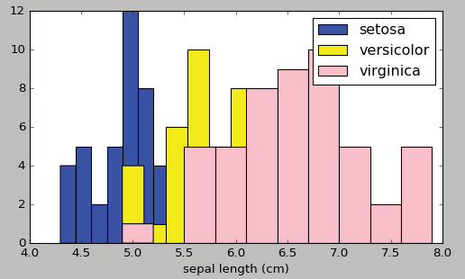
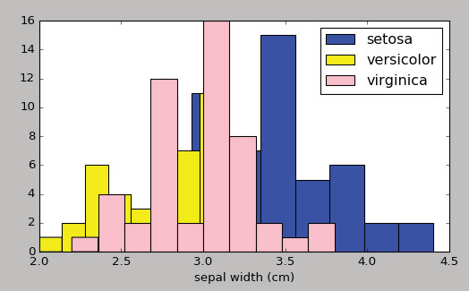
each iris feature is distributed among
three flower species. We have plotted the histogram of the
targets with respect to each feature of the data set. We can
clearly see the feature ‘petal width’ can distinguish better
than sepal length, sepal width and petal length.

Slide 8
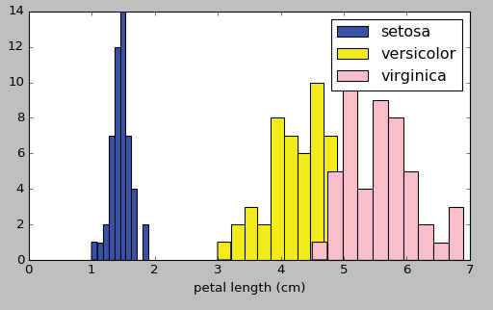
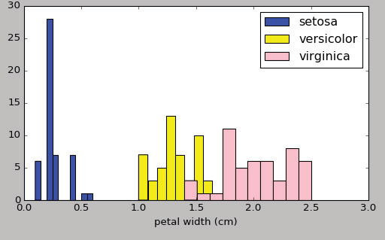

Slide 9
B. Loading
First we have collected dataset of Iris flower from UCI
Machine Learning Repository. There are total 150 samples
belong to three various species of Iris flower that is setosa,
versicolor, virginica. In the next step, collected dataset is
loaded into the machine learning model. Here, we have used
scikit learn tool and load_iris( ) python function to import
the Iris dataset from scikit-learn datasets. This function is
used to run and save return value in an object called “Iris”.
Then the attributes are assigned. In the Iris flower dataset
attributes are data, feature names, target etc. and the target
name for the Iris are classes that is setosa, virginca,
versicolor. Feature names are nothing but sepal length, petal
length, sepal width, petal width. Then dataset is divided into
train and test data. Test data size is set to 40% while
remaining 60% is kept for training purpose from the original
dataset. Also random_state is set to 0. We should set
random state to some random number. Because, if we run
the model without specifying random_state we will get a
different result every time when we execute, which makes
difficulty in the accuracy analysis.

Slide 10
C. Model selection
In this step we have imported the model, based on which
species prediction should be done. From scikit-learn tool,
three classifiers are imported as follows:
1) Support Vector Machine
SVM is a promising new strategy for the arrangement of
both linear and non-linear information. It utilizes the non
linear mapping to change the first preparing information
into a higher measurement. Inside this new parameter, it
looks for the isolating hyperplane. The hyperplane
utilizes set of vectors. Support vector machine is a
supervised machine learning algorithm which is used for
both classification and regression problems. In this
algorithm, we have plotted data item in n dimensional space (n is number of features considered in IRIS dataset) and then classification has been done.

Slide 11
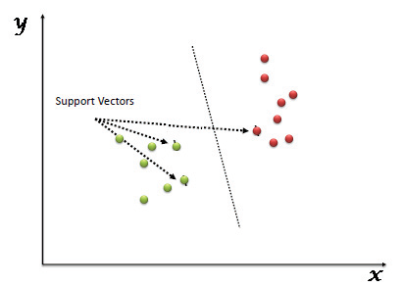
SVM Hyper plane
We have implemented learning model using SVM algorithm. SVC( ) function of sklearn is used to import the model. Predictions are made on the input test set. After comparing the actual response values with predicted response values, we got the SVM model accuracy as 96%.
2) Logistic regression
Logistic Regression is a statistical method for dataset
analysis in which, there are one or more independent
variables that determine the output.

Slide 12
The main objective of logistic regression is, it is a way used to split the data to get an accurate prediction of the class which uses the present information. Here in this Iris flower dataset, we are examining the Iris dataset. This classifier finds the method
to split the given data based on length, width of Iris flower.
One of the famous classification algorithms is logistic
regression to analyze the target feature. It is a Nonlinear
function which uses the sigmoid function as hypothesis
which is given by p=1/(1+e-y). Here categorical and binary
data are taken as the target variable. It is based on binary
outcome i.e. 1/0 or Yes/No or True/False. Logistic
Regression works well with large dataset.
LogisticRegression( ) function from sklearn.linear_model is used here to import the model. After examining the Iris dataset on the basis of logistic regression we got the model accuracy as 91%.

Slide 13
3) K- Nearest Neighbor Classifier
K-Nearest Neighbor is used for both classification and
regression problems. KNN belongs to supervised learning.
This algorithm is easy to understand. KNN model is entirely
based on the training dataset. Here whenever we require
prediction for unseen data, this algorithm will search for kmost
similar instances. K-nearest neighbor classifier is
powerful because, in order to perform classification it will
measure the distance between two instances to find the
similarity. Then based on the similarity, it will classify the
incoming data.
For implementation of KNN classifier, we have used
KneighborsClassifier(n_neighbors=3) function from
sklearn.neighbors package. Based on the predictions, we got
the model accuracy as 93%

Slide 14
D. Cross validation
Cross validation is a technique to reserve a particular sample of a dataset using which model is not trained. Each training subset is validated with this portion of sample data before finalizing. While validating, first we have to reserve the sample of dataset, and next we have to train this model by using left over part of the dataset. And again we have to use reserve samples of the test set or validation set which is helpful for the effectiveness of model performance.
Cross Validation steps:
i) First we should reserve sample data
ii) Train the model using remained portion of the
datasets
iii) To check model’s performance, now we should reserve sample of the test set. If the model gives good
result with this validation data, then that model can be considered as a good model. The main advantage of cross validation is to get more
accurate estimate result from the sample accuracy and it is more efficient and helpful for the effectiveness of model performance.

Slide 15
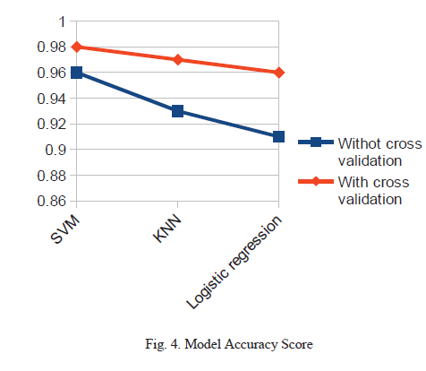

Slide 16
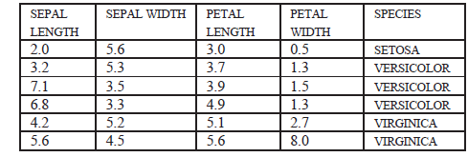
E. Confusion Matrix
A Confusion matrix is a table to describe classification
model performance. It is based on test data for which,
output label is already known. Confusion matrix gives clear
idea about model is giving proper outcome or not. Also it is
easy to identify the model errors. We have calculated model
accuracy score using confusion matrix.
TABLE I. ILLUSTRATION OF SAMPLE IRIS DATASET

Slide 17






Software Used
Module used

Slide 18
References
[1] Diptam Dutta, Argha Roy, Kaustav Choudhury, “Training Aritificial
Neural Network Using Particle Swarm Optimization Algorithm”,
International Journal on Computer Science And Engineering(IJCSE),
Volume 3, Issue 3, March 2013.
[2] Poojitha V, Shilpi Jain, “A Collecation of IRIS Flower Using Neural
Network CLusterimg tool in MATLAB”, International Journal on
Computer Science And Engineering(IJCSE).
[3] Vaishali Arya, R K Rathy, “An Efficient Neural-Fuzzy Approach For
Classification of Dataset”, International Conference on Reliability,
Optimization and Information Technology Feb 2014.
[4] Cho, SungBae.and Dehuri, Satchidananda (2009) “A comprehensive
survey on functional link neural network and an adaptive PSOBP
learning for CFLNN, Neural Comput &
Application”DOI10.1007/s00521-00902885
[5] Patric s hoye “stastical analysis of iris flower dataset” University of
[6] Massachusetts At Lowell
[7] Card, S., Mackinlay, J., and Shneiderman, B. Information

